Slide 1
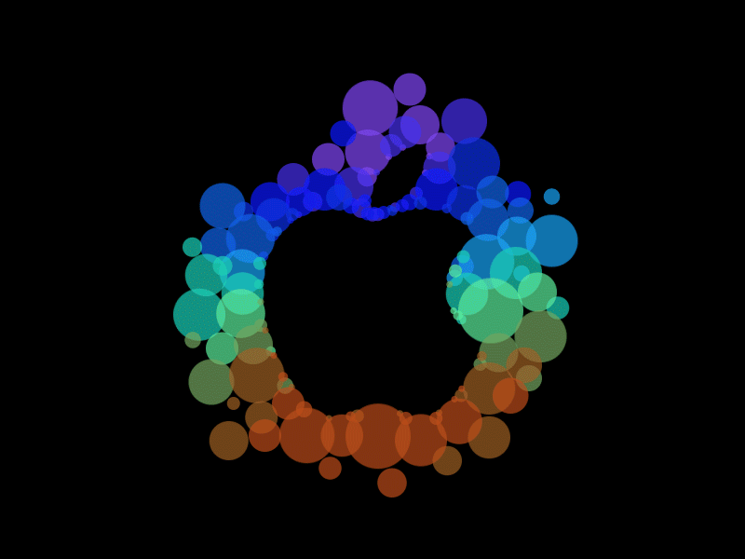
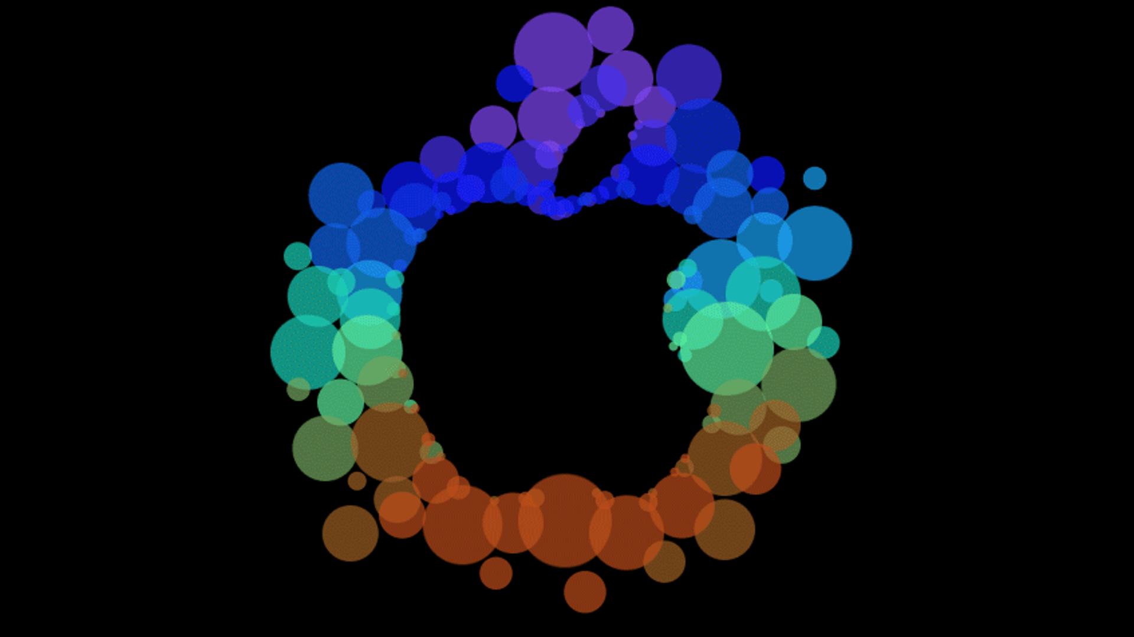
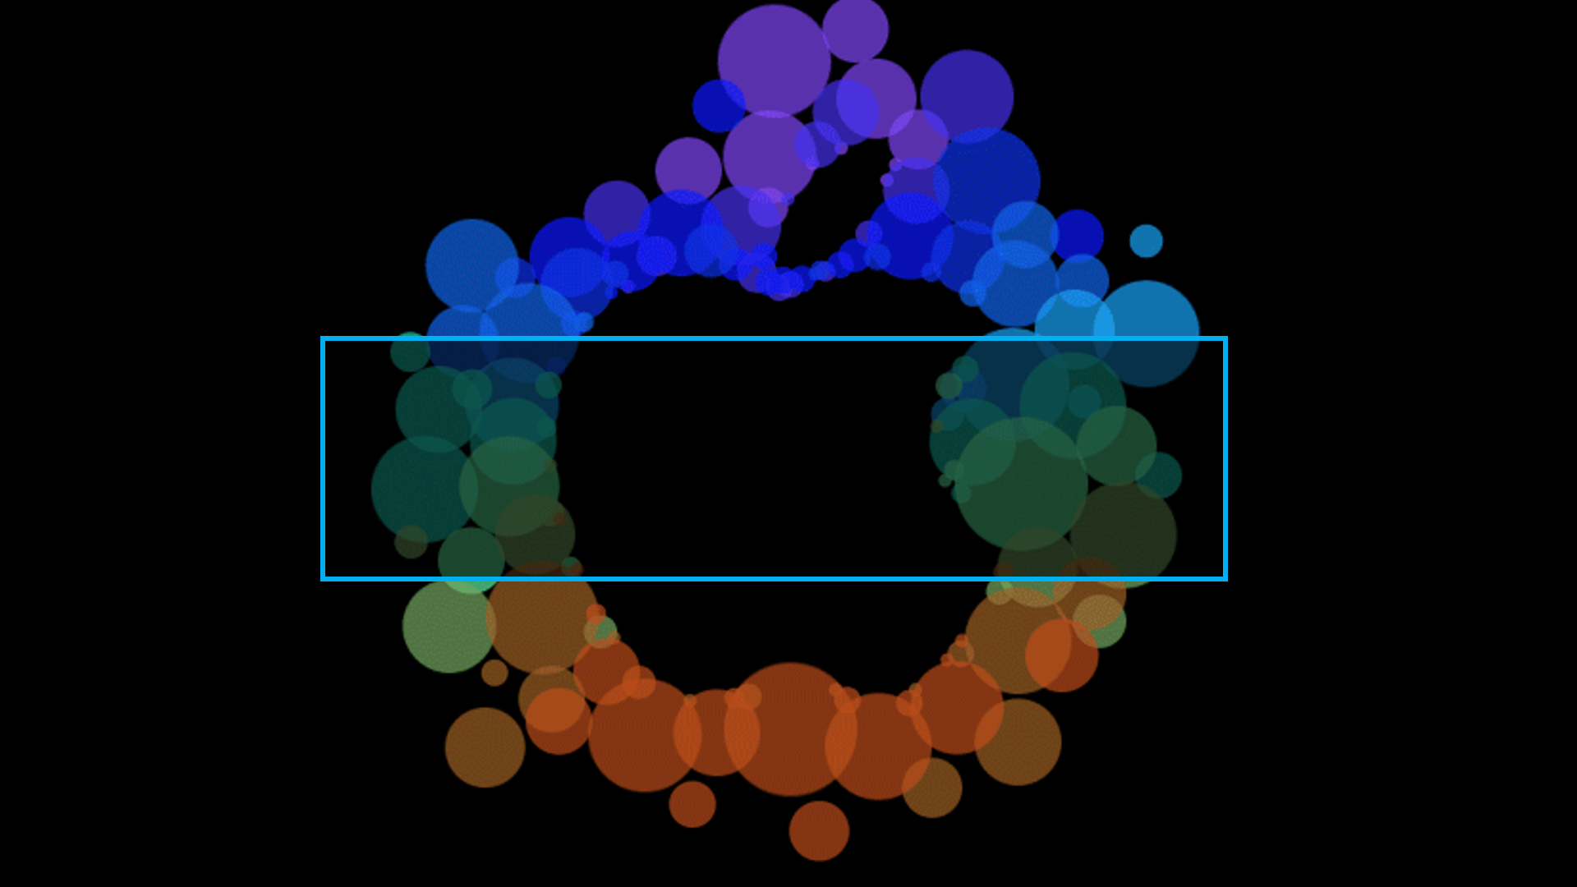
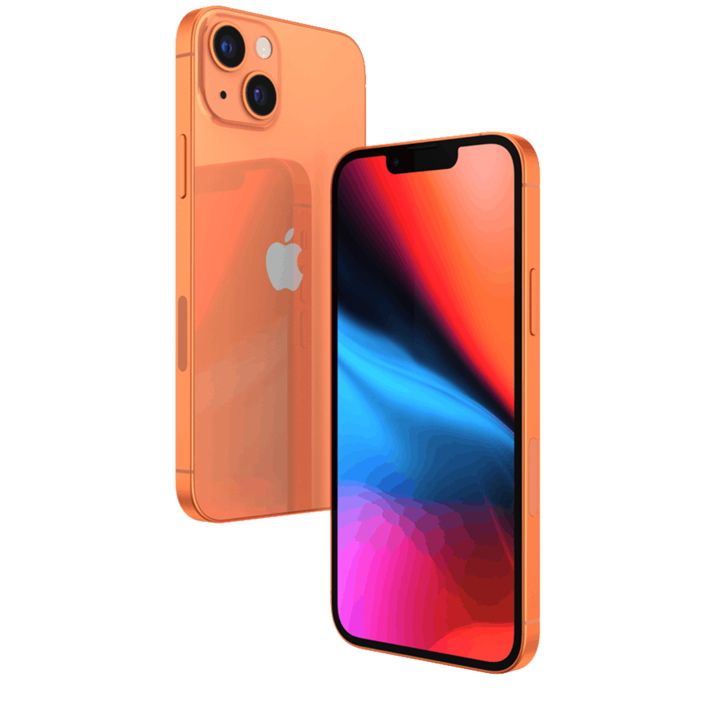
A
P
P
L
E
iPhone 13 Pro

Slide 2


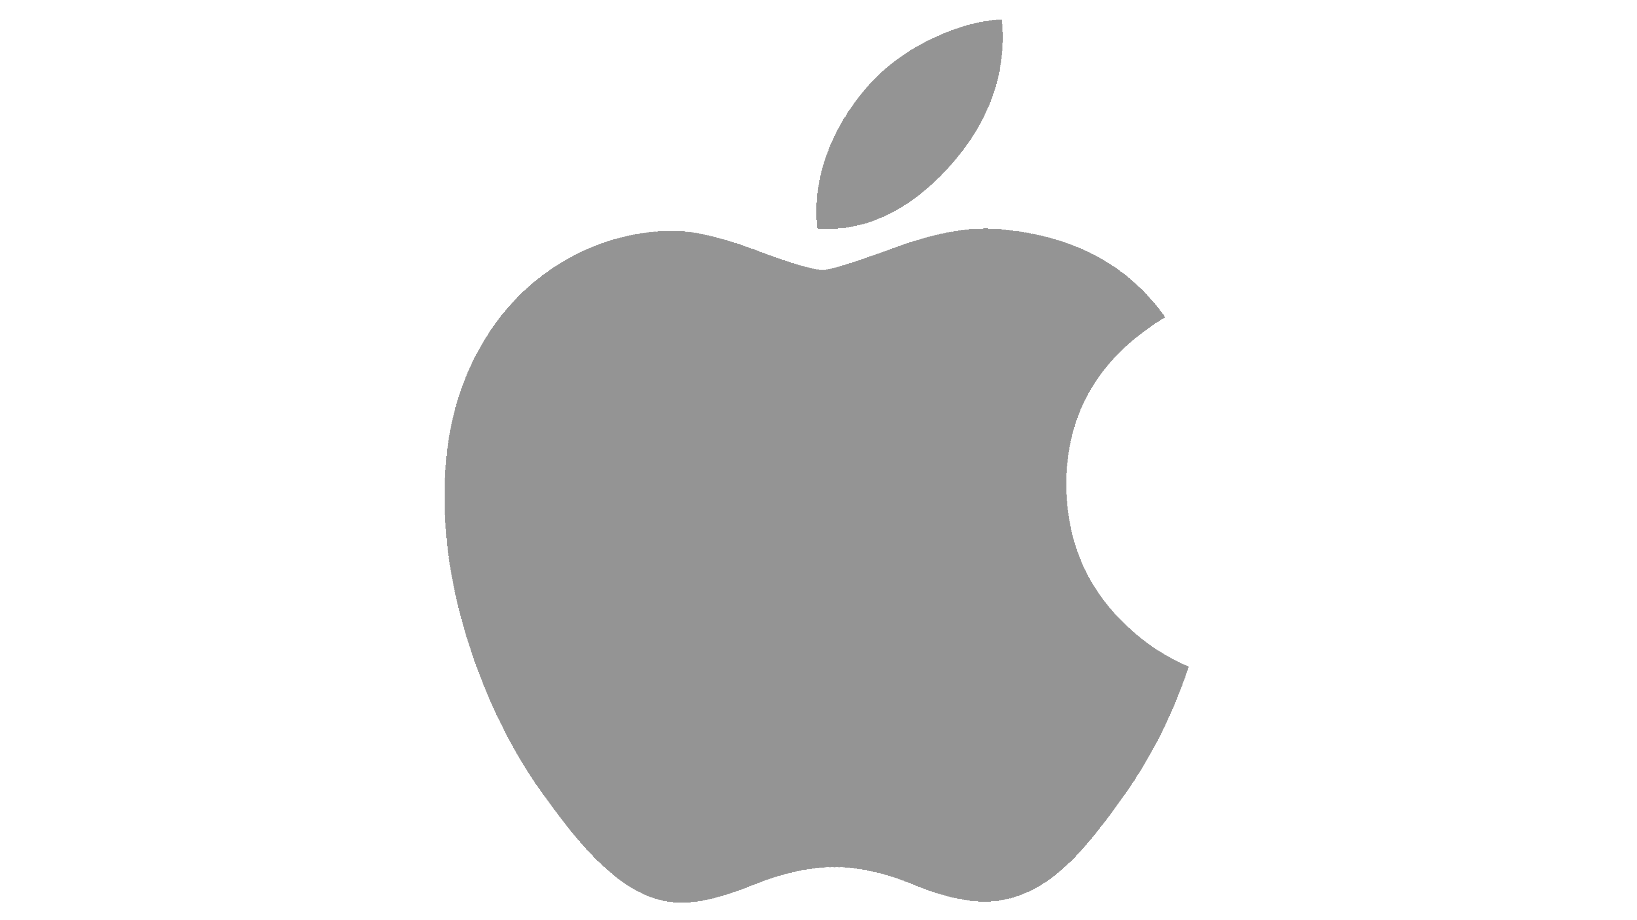
Index
1
Apple Focus and Goals
6
Product Life Cycle
2
Apple History
7
Connection With Clients
3
iPhone 13 Pro Product Details
8
Apple in Technology Market
4
iPhone 13 Pro Characteristics
9
Apple Marketing Strategies
5
iPhone 13 Product Levels
10
Conclusion

Slide 3
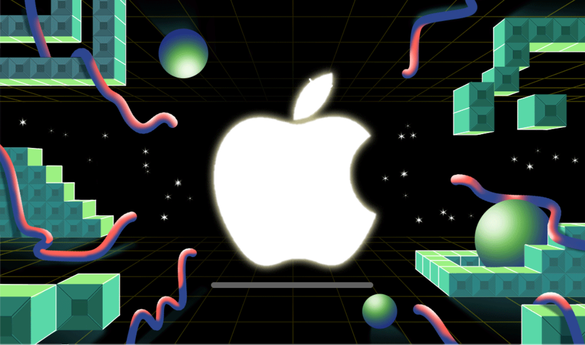
Apple is the largest company by market capitalization
FOCUS:
GOALS:
Technology.
User-friendliness.
Product quality.
Minimalism.
Innovation.
Loyalty.
Design.
Develop.
Sell electronic products.
&
1

Slide 4
Apple History
1976
On April 1, Apple was founded by Steve Jobs, Steve Wozniak, and Ronald Wayne.
2001
Ipod & iTunes.
1976
On April 11 the first Apple product was launched- the Apple I microcomputer (without a monitor or mouse).
2007
iPhone.
1976
On July 1 the first Apple logo was designed by Ronald Wayne.
2018
Apple Watch.
Apple uses various product release methods, including social media announcements, designated release dates, private product events, and pre-order periods.
2

Slide 5
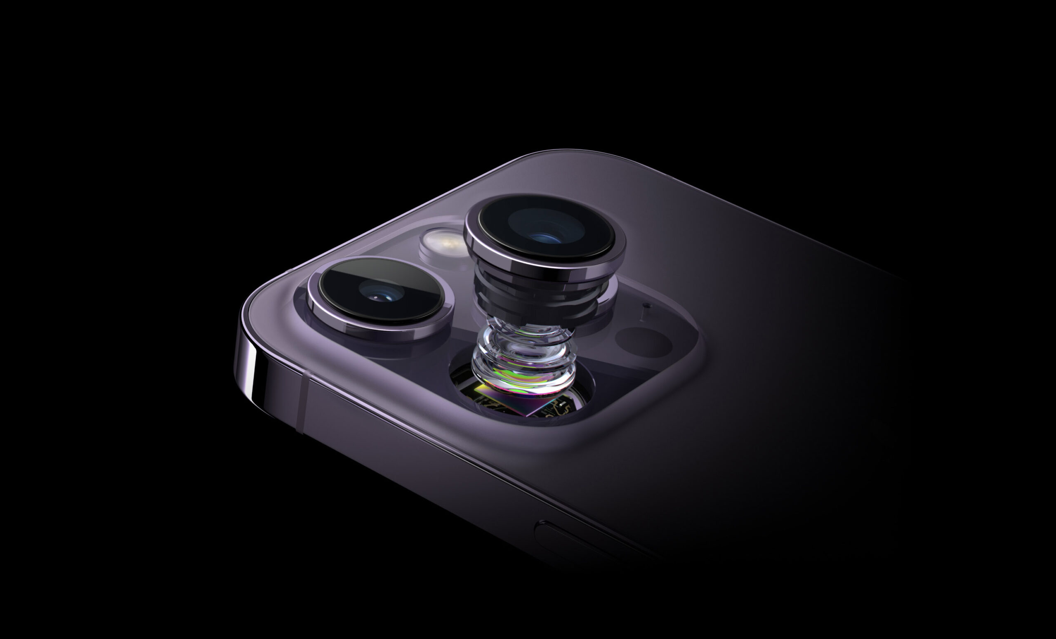
iPhone 13 Pro
Product Details
Apple is a company with a long history in technology and customer access, and the iPhone 13 Pro is an example of how to build future wonders. It features new camera options, apps, and longer battery recharges.
3

Slide 6
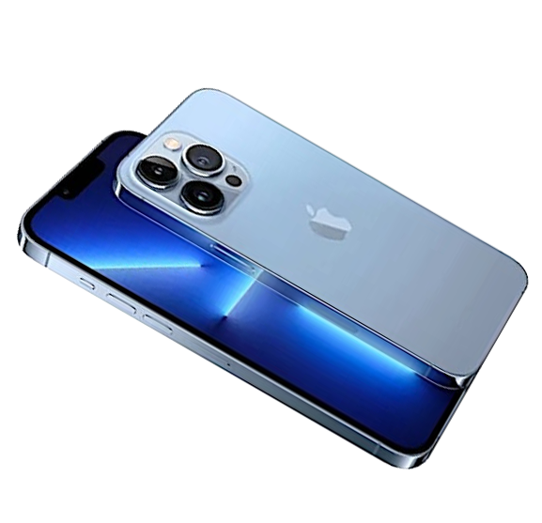

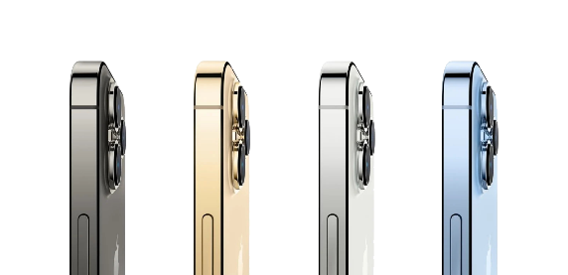


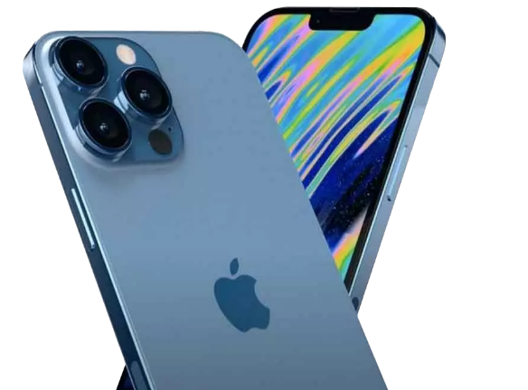



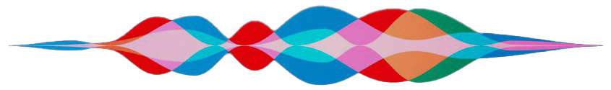

iPhone 13 Pro Characteristics
Brand new Colours
Apple Podcasts
Heartbeat Sensor
Tracks
Workout
Flat Sided
Design
4K
Apple Maps
4k60 fps
Camera
Apple Music
Fast
Charging
Powerful
Chip
All day Battery
Wi-Fi 6
Improved Siri
Apple Maps
4

Slide 7
iPhone 13 Product Levels
The iPhone 13 Pro offers a stable internet connection, call and message service, base applications, and the Apple signature, camera.
This camera has become the mainstay of the basic functions offered by an iPhone cell phone, and Apple is characterized by having special control over the extra functions. This includes options for entertainment, organization, and simplicity.
The iPhone 13 Pro is a new product from Apple, featuring improved cameras, storage, and battery life. It also offers a one-year warranty and can be purchased on the Apple website or in the official application.
5

Slide 8



Product life cycle
6

Slide 9
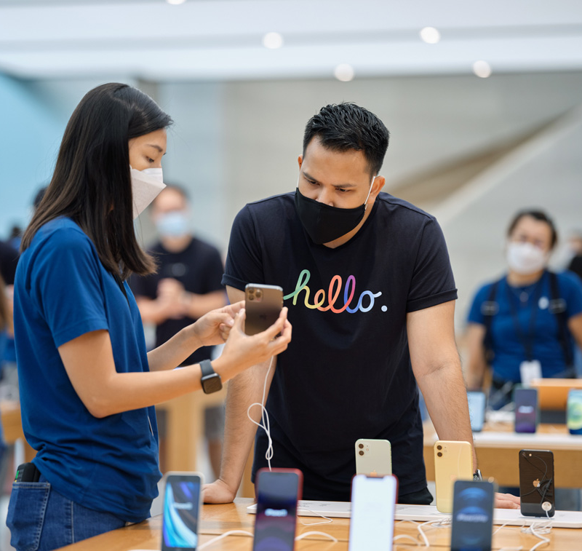
Connection With Clients
The iPhone 13 Pro has better features that give the model an advantage in terms of graphics and photography. The iPhone 13 Pro is intended for people who want to have a powerful device capable of taking high-quality photos.
Maslow's analysis suggests that an individual experiences many needs that can be prioritized.
Apple stands out from its competitors by managing to generate a need that is not a need. Marketing exists in a context, and Apple's product meets a certain need for the targeted population.
7

Slide 10
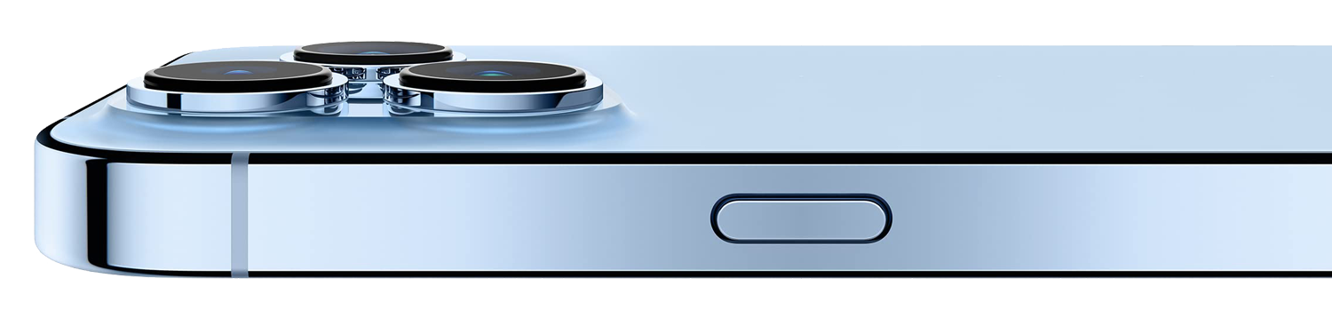
The need to belong is satisfied by a process of membership, an activity, or symbols of belonging. The need for esteem corresponds to prestige, success, recognition, and social rank.
Apple has targeted these needs first and foremost, making it the market leader today.
Apple has chosen to have a short product range each year, which is an advantage for consumers.
It positions itself at the top end of the market with its range of products.
Connection With Clients (2)
7

Slide 11
Apple in Technology Market
Apple is a premium and cutting-edge brand that has established a reputation for providing high-quality, user-friendly, and innovative goods and services. Their pricing approach mirrors this posture, with Apple goods often costing more than competitors’. They also make sure to have a reduced stock to encourage the consumer to wait and desire. Apple is one of the leaders in the market of smartphones, with Samsung as their main competitor. Samsung's Galaxy series competes directly with Apple's iPhone lineup, providing a wide selection of smartphones powered by Android.
8

Slide 12

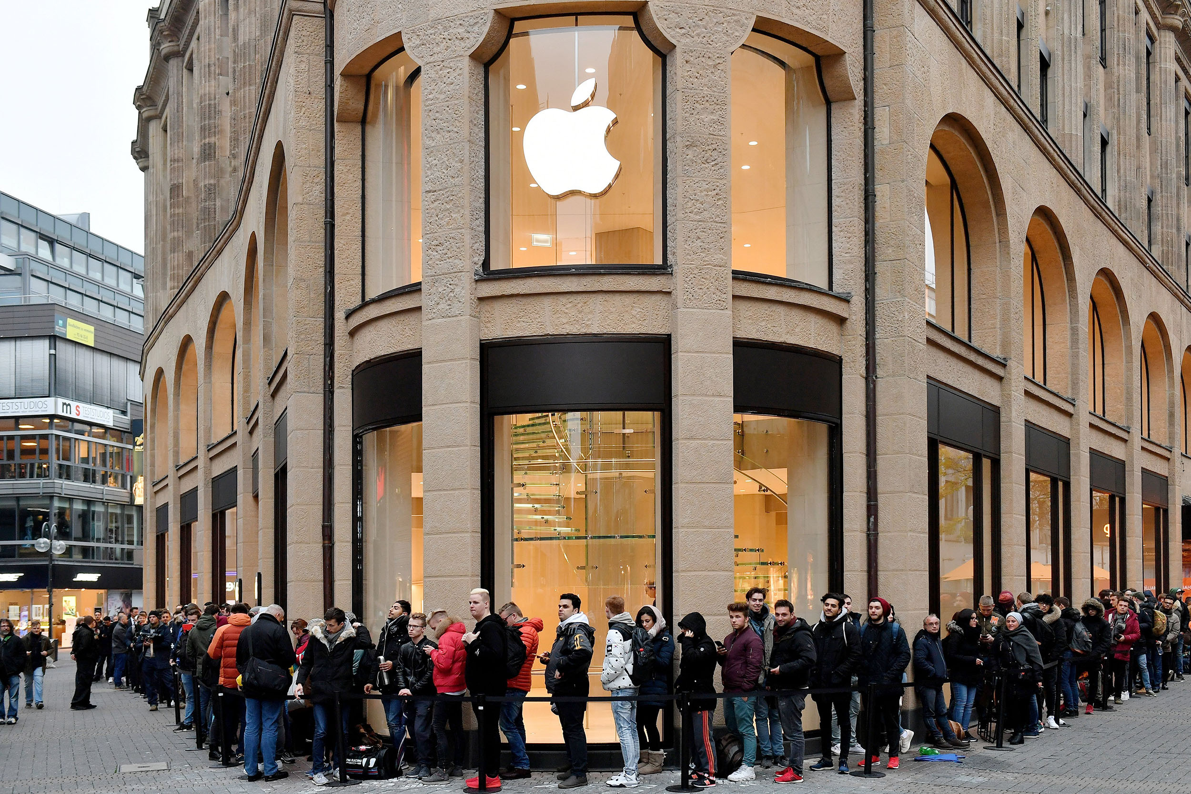
APPLE MARKETING STRATEGIES
9
Apple's iPhone marketing approach emphasizes its distinct capabilities and features, providing a smooth and intuitive user experience, and orchestrating events to generate hype, media coverage, and customer anticipation.

Slide 13
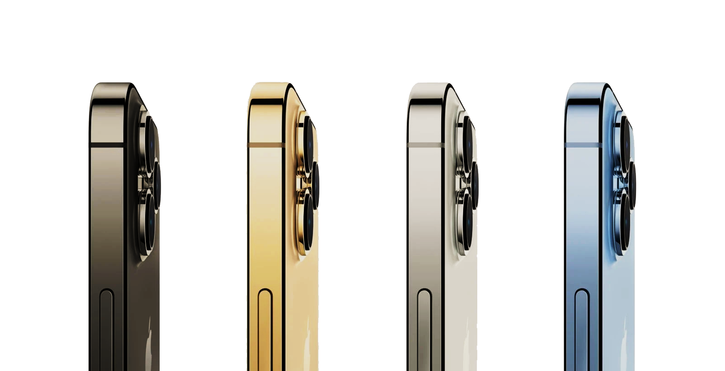
CONCLUSION
Apple's iPhone 13 Pro exemplifies its commitment to continuous improvement, providing a comprehensive user experience and creating a sense of belonging and esteem among its consumers. It also defies the traditional stages of introduction, growth, maturity, and decline.
Apple's success lies in its products and ability to create a community and convey a distinct brand identity. It embodies the brand's values of simplicity, innovation, and creativity while satisfying consumers' desire for a powerful and prestigious device.
10

Slide 14
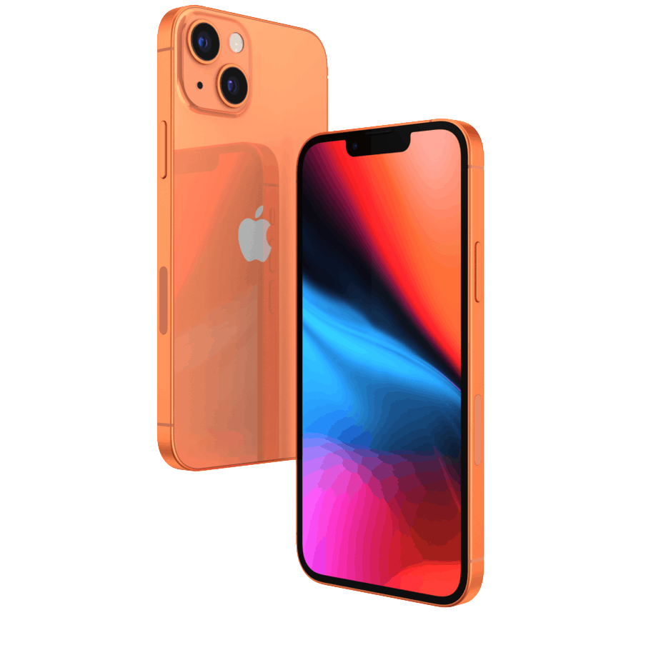
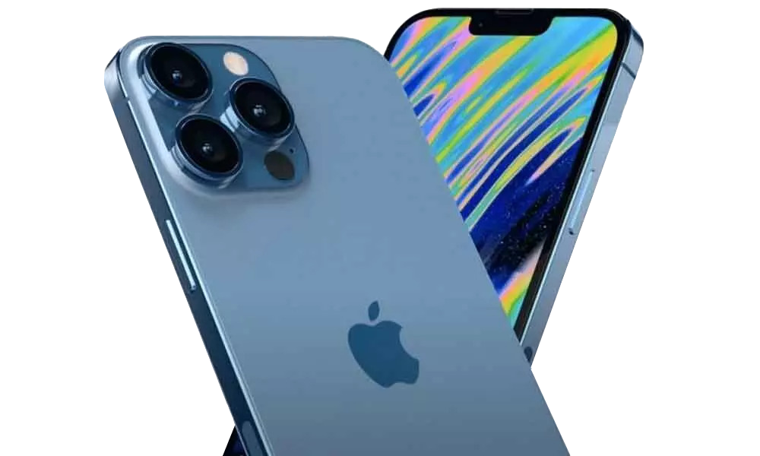
THANK YOU FOR YOUR ATTENTION
Aleksandra Vujisic - av126017 Andrzej Guerrero - ad121340
Luis Silvano - ls126206 Naoufel Moreau - nm126221
Teoodora Dulovic - td127526

